Slide 1
An Application of Fractional Factorial Designs to Study Drug Combinations
Student Name: Liyuan Zhu
Student ID Number:202012180

Slide 2
Abstract:
A new application to investigate a biological system with HSV-1 and six antiviral drugs.
A two-level FFD--model inadequacy---A three-level FFD---
A blocked three-level FFD---TNF-alpha has little effect and HSV-1 infection can be suppressed effectively by using a right combination
Key words
blocking; drug combination; effect aliasing; experimental design; fractional factorial design;Herpes simplex virus
Methodology
Two level Full factorial design and Fractional factorial design, Three-level blocked fractional factorial design

Slide 3
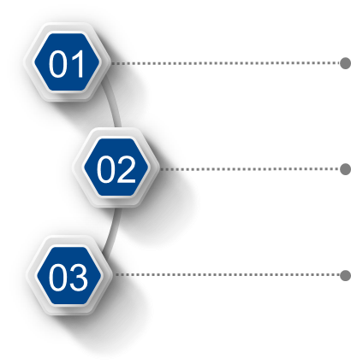
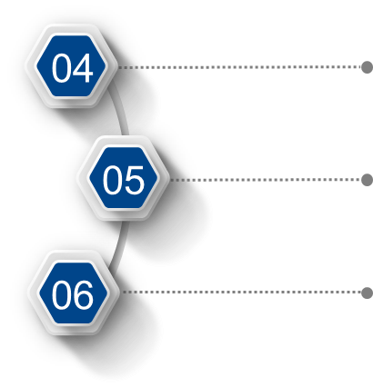
Drugs explanation
Fractional Factorial Designs

Slide 4






Two-level experiment
Three-level experiment
Conclusion

Slide 5

1.1 Full factorial design
Suppose we have a full factorial design studying the six antiviral drugs: A, B, C, D, E, and F with two levels for each drug. There are 2^6 = 64 treatments or level combinations
Regression model
6 main effects 15 two-factor interactions 20 three-factor interactions
15 four-factor interactions 5 five-factor interactions 1 six-factor interaction
63 df in total, but 42 are used for estimating three factor or higher interactions

Slide 6
1.2 Fractional factorial design
we study six drugs in the antiviral drug experiments, in 2^6−1 = 32 runs, a half fraction of the full 2^6 design
F=ABCDE
Then we have
A = BCDEF, B = ACDEF, C = ABDEF, D = ABCEF, and E = ABCDF.
AB = CDEF, AC = BDEF, …, EF = ABCD
ABC = DEF, ABD = CEF, …, AEF = BCD
This half-fraction design has resolution VI

Slide 7
Table 1: Design and data for the initial two-level experiment: A 26−1 design
Design and data for the initial two-level experiment: A 2⁶⁻¹ design
Run | Factor |  |  |  |  |  | readout
 | A | B | C | D | E | F
1 | −1 | −1 | −1 | −1 | −1 | −1 | 31.6
2 | −1 | −1 | −1 | −1 | 1 | 1 | 32.6
3 | −1 | −1 | −1 | 1 | −1 | 1 | 13.4
4 | −1 | −1 | −1 | 1 | 1 | −1 | 13.2
5 | −1 | −1 | 1 | −1 | −1 | 1 | 27.5
33 | 0 | 0 | 0 | 0 | 0 | 0 | 16.8
34 | 0 | 0 | 0 | 0 | 0 | 0 | 17.5
35 | 0 | 0 | 0 | 0 | 0 | 0 | 16.2

Slide 8
1.3Analysis and results Table 2:Estimates for the initial two-level experiment
Effect | Estimates | Sum Sq. | % Sum Sq.
A | 0.017 | 0.009 | 1
B | 0.03 | 0.029 | 3.1
C | 0.008 | 0.002 | 0.2
D | −0.141 | 0.636 | 68
E | 0.046 | 0.068 | 7.3
F | 0.024 | 0.018 | 1.9
AB | −0.022 | 0.015 | 1.6
AC | 0.005 | 0.001 | 0.1
AD | 0.019 | 0.011 | 1.2
AE | −0.009 | 0.002 | 0.3
AF | 0.005 | 0.001 | 0.1
BC | −0.009 | 0.003 | 0.3
BD | 0.008 | 0.002 | 0.2
BE | 0.008 | 0.002 | 0.2
BF | −0.008 | 0.002 | 0.2
CD | 0.024 | 0.018 | 1.9
CE | 0.002 | 0 | 0
CF | 0.003 | 0 | 0
DE | 0.001 | 0 | 0
DF | 0.014 | 0.006 | 0.7
EF | −0.001 | 0 | 0
ABC+DEF | −0.002 | 0 | 0
ABD+CEF | 0.002 | 0 | 0
ABE+CDF | −0.006 | 0.001 | 0.1
ABF+CDE | −0.001 | 0 | 0
ACD+BEF | −0.017 | 0.009 | 0.9
ACE+BDF | −0.015 | 0.007 | 0.8
ACF+BDE | −0.012 | 0.004 | 0.5
ADE+BCF | −0.004 | 0 | 0
ADF+BCE | −0.009 | 0.002 | 0.2
AEF+BCD | 0.014 | 0.007 | 0.7
Residuals | - | 0.077 | 8.3
Total | - | 0.935 | 100

Slide 9
Table 3 suggests that
The effects of drugs D and E are the largest
Drug D is very significant and important relative to the other drugs
Six main effects: 81.5%,15 two factor interactions : 6.8%
D has negative coefficients: A,B,C,E,F at low level, D at the high level

Slide 10
Lack-of-fit table 3：Lack-of-fit Test
Source | DF | Sum Sq. | Mean Sq. | F-statistic | p-value
Lack-of-fit | 1 | 0.07663 | 0.07663 | 272.46 | 0.0037
Pure error | 2 | 0.00056 | 0.00028
Residuals | 3 | 0.07719
1 Lack-of-fit is very significant with an F value of 272.46 and a p-value of 0.0037
2 The relationship between the response and the drugs is nonlinear
3 We need additional levels and runs to model the nonlinear relationship

Slide 11
2 Follow up three level experiment
2.1 Experimental design
We use three levels for each drug, the three levels are denoted as low (0), intermediate (1), and high (2)
Table 4:Factors and levels for the follow-up three-level antiviral drug experiment
Factor | Levels
 | Low (0) | Mid (1) | High (2)
A= Interferon-alpha | 0 | 0.78 ng/mL | 12.5 ng/mL
B= Interferon-beta | 0 | 0.78 ng/mL | 12.5 ng/mL
C= Interferon-gamma | 0 | 0.78 ng/mL | 12.5 ng/mL
D= Ribavirin | 0 | 390 ng/mL | 6250 ng/mL
E= Acyclovir | 0 | 80 ng/mL | 1250 ng/mL
F= TNF-alpha | 0 | 0.08 ng/mL | 1.25 ng/mL

Slide 12
3⁶⁻² design
E = ABCD and F = AB²C
x₅ = x₁ +x₂ +x₃ +x₄ (mod 3) and x₆ = x₁ +2x₂ +x₃ (mod 3)
This design has resolution IV
Batch to batch variation
Blocking is a useful way to reduce the influence

Slide 13
A 3⁶⁻² design in 3 blocks
Block = AC²D, or equivalently block= x1 + 2x3 + x4 (mod 3)
Table 5:Design and data for the follow-up three-level experiment: A 3⁶⁻² design in 3 blocks
Run | A | B | C | D | E | F | block | readout
1 | 0 | 0 | 0 | 0 | 0 | 0 | 0 | 49.1
2 | 0 | 1 | 0 | 0 | 1 | 2 | 0 | 37.2
3 | 0 | 2 | 0 | 0 | 2 | 1 | 0 | 39.9
4 | 1 | 0 | 1 | 0 | 2 | 2 | 0 | 28.7
5 | 1 | 1 | 1 | 0 | 0 | 1 | 0 | 41.8
79 | 2 | 0 | 2 | 2 | 0 | 1 | 2 | 2.6
80 | 2 | 1 | 2 | 2 | 1 | 0 | 2 | 18.2
81 | 2 | 2 | 2 | 2 | 2 | 2 | 2 | 2.6

Slide 14
2.2 Analysis
To analyze the data, we fit a second-order model with the addition of the block effects
β_{i} represents the linear effect of x_{i}
β_{ii} represents the quadratic effect of x_{i}
β_{ij} represents the bilinear interaction between x_{i} and x_{j}
The three dosage levels (0, 1, and 2) are encoded as −1, 0, 1

Slide 15
Table 6 Estimates for the follow-up three-level experiment
(a) | (b)
(Intercept) | 0.761*** | 0.761***
A | −0.018 | −0.037
B | −0.054* | −0.054**
C | −0.027 | −0.046*
D | −0.491*** | −0.509***
E | −0.119*** | −0.119***
F | −0.007 | 0.011
A² | 0.046 | 0.028
B² | −0.026 | 0.011
C² | −0.008 | −0.026
D² | 0.185*** | 0.167***
E² | 0.018 | 0.054
F² | 0.069 | 0.051
AB | 0.028 | 0.01
AC | 0.047 | 0.005
AD | 0.105*** | 0.078**
AE | 0.036 | 0.036
AF | −0.05 | −0.013
BC | 0.012 | −0.006
BD | −0.02 | −0.02
BE | 0.041 | 0.023
BF | −0.052 | −0.025
CD | 0.055 | 0.028
CE | −0.029 | −0.029
CF | −0.019 | 0.018
DE | 0.021 | 0.007
DF | 0.000 | 0.036
EF | −0.038 | −0.038
block1 | −0.327*** | −0.327***
block2 | −0.139** | −0.176***
σˆ | 0.177 | 0.142
R² | 0.914 | 0.945
(a)
1 The effects D,E, D², and AD are significant at the 0.1% level;
2 The effect B is significant at the 5% level;
3 R² value is 91.4%;
4 Blocking variables are significant at the 1% level, batch-to-batch variation is large
(b)
1 Significant effects identified earlier remain significant
2 B becomes more significant and C becomes significant at the 5% significance level.
3 R² value is 94.5%

Slide 16
The final model at the 1% significance level is
with R² of 92%. The linear effect A is not significant, but we keep the term in the model because the interaction AD is significant

Slide 17
2.3 result
B,C,D,E have a significant linear effect on HSV-1
Interaction AD has a significant effect
F is not significant

Slide 18
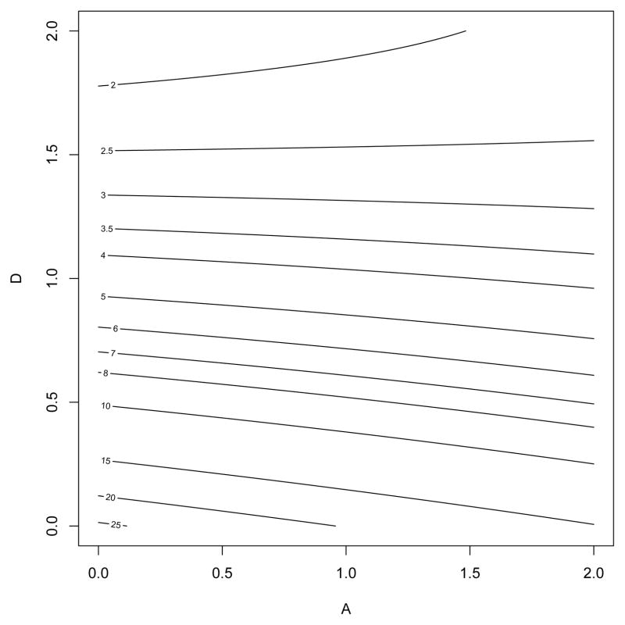
a.The plot of predicted readout for A and D
1 The contour plot of the predicted readout in terms of A and D, while drugs B, C, and E are held at the high level and block1 = block2 = 0
2 The minimum viral infection is achieved when A is set at the low level, no drug, and D is set at the high level
3 The optimal drug combinations to minimize the viral infection for the final model are: B, C, D, and E at the high level and A at the low level

Slide 19
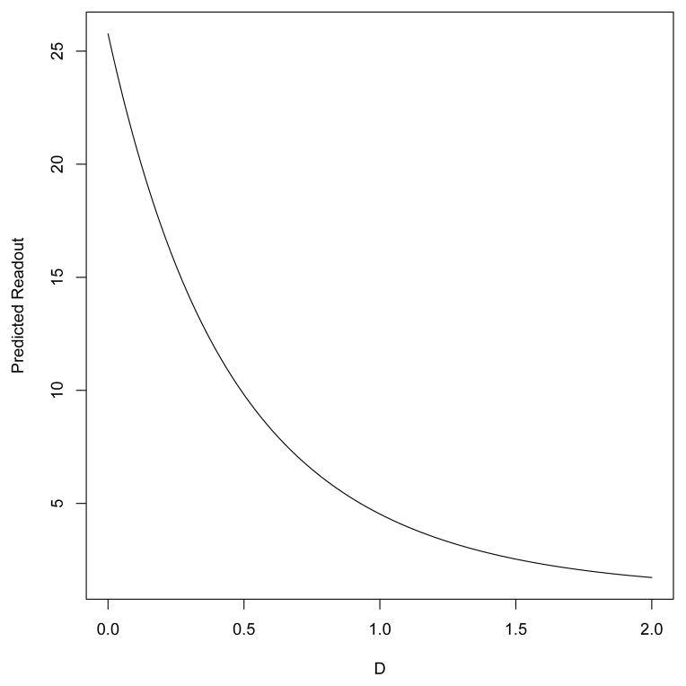
b. Plot of predicted readout for D
1 D is an effective drug, but can also induce toxic side effect
2 It shows the predicted readout for D using the model, with the setting recommended for the other drugs before.
3The shape is convex because the coefficient of D² is positive in model, the convexity means that reduce the Ribavirin dosage will not affect its efficacy substantially

Slide 20
3 conclusion
F has little effect, B, C, D, and E at the high level and A at the low level
HSV-1 infection can be suppressed effectively by using a right combination of the other five antiviral drugs.
Fractional factorial designs with large run sizes could be a viable alternative to high throughput methods.

Slide 21
Thanks for watching

